Slide 1
DevOps - Docker Intro

Slide 2
Agenda
What is Docker?
What is Container?
Docker History
Docker vs VM
Docker Technology
Docker Componets
Docker CLI
Docker Workflow
Workshop

Slide 3
What is Docker?
Docker is a computer program that performs operating-system-level virtualization, also known as "containerization".
[Source: en.wikipedia.org]

Slide 4
What is Container?
Container is an isolated user space in which computer programs run directly on the host operating system's kernel but have access to a restricted subset of its resources.
[Source: en.wikipedia.org]

Slide 5
Docker History
Docker started as an internal project within dotCloud by Solomon Hykes
Docker goes open source in March 2013
Docker switched from LXC to libcontainer in March 2014
Docker and other leaders annonce Open Container Initiative in June 2015

Slide 6
Docker History
Docker spin up Containerd and runc in December 2016
Docker natively on Windows in September 2016
Docker donate Containerd to CNCF in March 2017
Docker announce Containerd 1.0 GA in December 2017

Slide 7
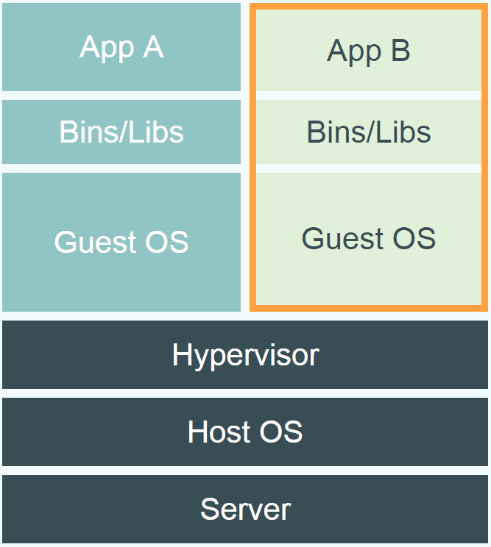
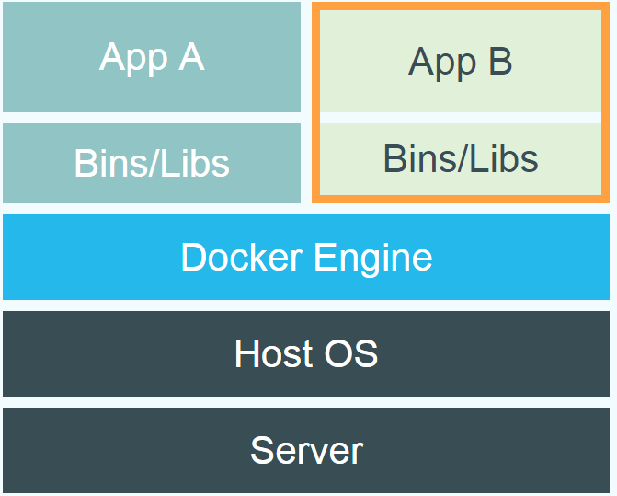
Docker vs. Virtual Machine

Slide 8
Docker Technology
Developed primarily for Linux and uses the resource isolation features of the Linux kernel such as cgroups and kernel namespaces, and a union-capable file system such as OverlayFS and others to allow independent "containers" to run within a single Linux instance.

Slide 9
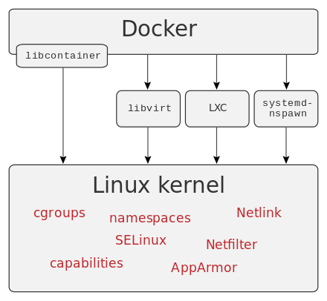
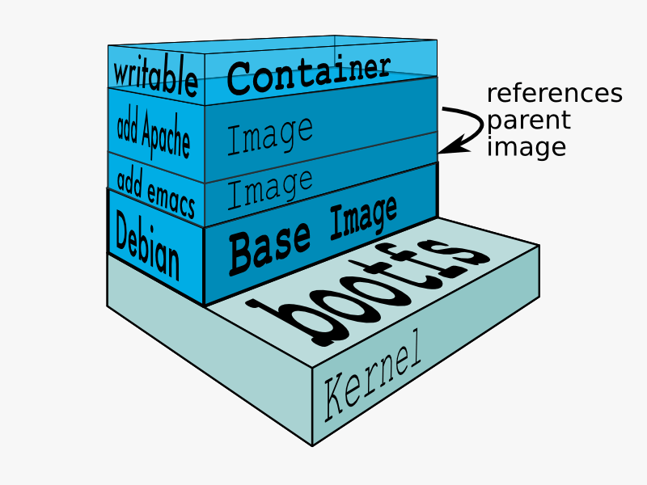
Docker Technology
[Source: https://docs.docker.com/terms/layer/]

Slide 10
Docker Components
Software:
dockerd – docker engine daemon
docker – docker client
Objects :
container – encapsulated environment that runs applications
image – read-only template used to build containers
service – abstraction of scalled containers (used with docker swarm)

Slide 11
Docker Components
Registries – repository for docker images
Tools:
compose – tool for defining and running multi-container docker applications
swarm – provides native clustering functionality for docker containers

Slide 12
Docker CLI – Building images
docker build [OPTIONS] PATH | URL | -

Slide 13
Docker CLI – Creating, running and stopping containers
docker run [OPTIONS] IMAGE [COMMAND] [ARG...]
docker create [OPTIONS] IMAGE [COMMAND] [ARG...]
docker start [OPTIONS] CONTAINER [CONTAINER...]
docker stop [OPTIONS] CONTAINER [CONTAINER...]
docker kill [OPTIONS] CONTAINER [CONTAINER...]
docker pause CONTAINER [CONTAINER...]
docker unpause CONTAINER [CONTAINER...]

Slide 14
Docker CLI – Interacting with running containers
docker attach [OPTIONS] CONTAINER
docker exec [OPTIONS] CONTAINER COMMAND [ARG...]
docker top CONTAINER [ps OPTIONS]
docker cp [OPTIONS] CONTAINER:SRC_PATH DEST_PATH|-
docker cp [OPTIONS] SRC_PATH|- CONTAINER:DEST_PATH
docker logs [OPTIONS] CONTAINER
docker wait CONTAINER [CONTAINER...]

Slide 15
Docker CLI – Saving and loading images and containers
docker save [OPTIONS] IMAGE [IMAGE...]
docker load [OPTIONS]
docker export [OPTIONS] CONTAINER
docker import [OPTIONS] file|URL|- [REPOSITORY[:TAG]]

Slide 16
Docker CLI – Removing images and containers
docker rm [OPTIONS] CONTAINER [CONTAINER...]
docker rmi [OPTIONS] IMAGE [IMAGE...]

Slide 17
Docker CLI – Communicating with Docker Registry
docker login [OPTIONS] [SERVER]
docker logout [SERVER]
docker push [OPTIONS] NAME[:TAG]
docker pull [OPTIONS] NAME[:TAG|@DIGEST]

Slide 18
Docker CLI – Help is your friend
docker [OPTIONS] COMMAND
docker --help
docker COMMAND --help

Slide 19
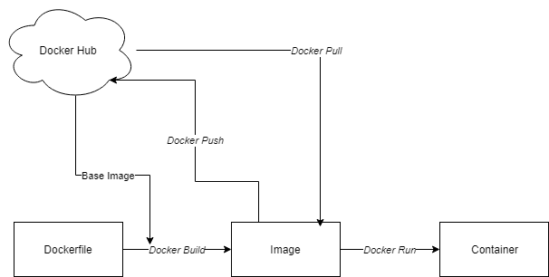
Docker Workflow

Slide 20
Dockerfile Instructions
FROM – sets the base Image for subsequent instructions
MAINTAINER* – set the author field of the generated image (deprecated)
LABEL – apply key/value metadata to your images, containers, or daemons
RUN – execute any commands in a new layer on top of the current image and commit the results
CMD – provide defaults for an executing container

Slide 21
Dockerfile Instructions
EXPOSE – informs docker that the container listens on the specified network ports at runtime
ENV – sets environment variable
ADD* or COPY – copies new files, directories or remote file to container (avoid ADD and use COPY instead)
ENTRYPOINT – configures a container that will run as an executable
VOLUME – creates a mount point for externally mounted volumes or other containers

Slide 22
Dockerfile Instructions
USER – sets the user name for following RUN / CMD / ENTRYPOINT commands
WORKDIR – sets the working directory
ONBUILD – adds a trigger instruction when the image is used as the base for another build
STOPSIGNAL – sets the system call signal that will be sent to the container to exit
ARG – defines a build-time variable

Slide 23
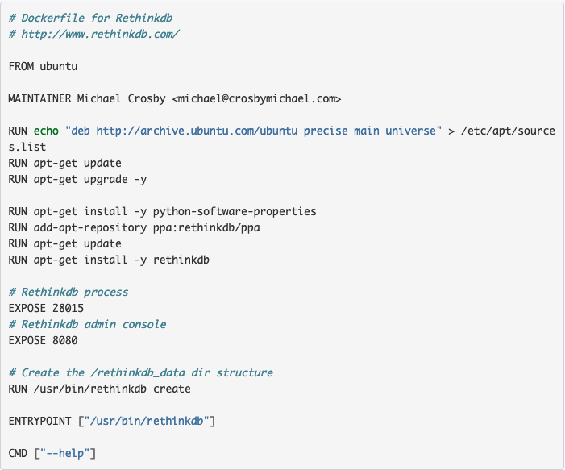
Dockerfile Example

Slide 24

Docker Workshop

Slide 25
Install Docker Community Edition
Docker CE for Ubuntu
https://docs.docker.com/install/linux/docker-ce/ubuntu/
Docker CE for CentOS
https://docs.docker.com/install/linux/docker-ce/centos/

Slide 26
Docker Hub
https://hub.docker.com/
Docker Hub is the world's easiest way to create, manage, and deliver your teams' container applications.

Slide 27
Run Container
Run new container and attach to terminal:
docker run –it ubuntu:18.04 /bin/bash
Make some modifications:
apt-get update && apt-get upgrade && apt-get install vim
vim /say-hello.sh
while [[ true ]]; do
echo ”Hello `date`”
sleep 1
done
chmod +x /say-hello.sh

Slide 28
Run Container
Create new image:
docker commit <container_id> <new_image_name>
Run new container as deamon:
docker run –d [image] /bin/bash /say-hello.sh
Check container logs:
docker logs [-f] <container_id>

Slide 29
Mount Volumes
Create new local script:
vim print-hello.sh
while [[ true ]]; do
echo ”Hello `date`” >> /var/log/hello.log
sleep 1
done
chmod +x print-hello.sh
Run new container as daemon:
docker run –d –v ${PWD}/print-hello.sh:/print-hello.sh [image] /bin/bash /print-hello.sh
Check container logs:
docker logs [-f] <container_id>

Slide 30
Publish Port
Sample application to show conatiner's hostname:
docker pull stenote/nginx-hostname
Expose application on default host port:
docker run –d –p80:80 stenote/nginx-hostname
Expose application on random host port:
docker run –d –P stenote/nginx-hostname
Expose application on specific host port:
docker run –d –p1080:80 stenote/nginx-hostname

Slide 31
Bridge Networking
List all available networks:
docker network ls
Expose application on default host port:
docker network create <my-net>
Check container network configuration:
docker inspect <container_id>
Create two containers and validate conectivity (package: iputils-ping):
docker run --network my-net --rm -it --name one ubuntu:18.04 bash
docker run --network my-net --rm -it --name two ubuntu:18.04 bash

Slide 32
Simple Dockerfile
Create simple Dockerfile based on ubuntu:18.04 with:
packages update
packages upgrade
extra script say-hello.sh
entrypoint /bin/bash
/say-hello.sh as command
Verify:
image size
number of layers
layers size

Slide 33
Simple Dockerfile
FROM ubuntu:18.04 LABEL maintainer="Dawid Malinowski <d.malinowski@idemia.com>" COPY say-hello.sh /say-hello.sh RUN chmod +x /say-hello.sh RUN apt-get update RUN apt-get upgrade -y ENTRYPOINT [ "/bin/bash" ] CMD [ "/say-hello.sh" ]

Slide 34
Optimize Simple Dockerfile
Optimize size of the image:
squash commends
remove cache files
Verify:
image size
number of layers
layers size

Slide 35
Optimize Simple Dockerfile
FROM ubuntu:18.04
LABEL maintainer="Dawid Malinowski <d.malinowski@idemia.com>"
COPY say-hello.sh /say-hello.sh
RUN chmod +x /say-hello.sh \
&& apt-get update \
&& apt-get upgrade -y \
# cleanup
&& apt-get clean autoclean \

Slide 36
Optimize Simple Dockerfile
&& apt-get autoremove --yes \
&& rm -rf /var/lib/{apt,dpkg,cache,log}/ \
&& rm -fr /tmp/* /var/tmp/*
ENTRYPOINT [ "/bin/bash" ]
CMD [ "/say-hello.sh" ]

Slide 37
Docker Base Image – Java
Create base image based on ubuntu:18.04 with:
openjdk 1.8 (openjdk-8-jre-headless vs openjdk-8-jre)
java as entrypoint
version as command

Slide 38
Docker Base Image – Java
FROM ubuntu:18.04
LABEL maintainer="Dawid Malinowski <d.malinowski@idemia.com>"
RUN apt-get update \
&& apt-get upgrade -y \
# install jre
&& apt-get install -y openjdk-8-jre-headless \

Slide 39
Docker Base Image – Java
# cleanup
&& apt-get clean autoclean \
&& apt-get autoremove --yes \
&& rm -rf /var/lib/{apt,dpkg,cache,log}/ \
&& rm -fr /tmp/* /var/tmp/*
ENTRYPOINT [ "/usr/bin/java" ]
CMD [ ”-version" ]

Slide 40
Docker Base Image – Nginx
Create base image based on ubuntu:18.04 with:
nginx 1.14
/usr/sbin/nginx as entrypoint
["-g", "daemon off;"] as command
HINTS:
nginx can print logs to stdout/stderr by adding:
ln -sf /dev/stdout /var/log/nginx/access.log && ln -sf /dev/stderr /var/log/nginx/error.log
Notes:
/usr/share/nginx/html

Slide 41
Docker Base Image – Nginx
FROM ubuntu:18.04
LABEL maintainer="Dawid Malinowski <d.malinowski@idemia.com>"
RUN apt-get update \
&& apt-get upgrade -y \
# install nginx
&& apt-get install -y nginx \
# configure console output
Notes:
/usr/share/nginx/html

Slide 42
Docker Base Image – Nginx
&& ln -sf /dev/stdout /var/log/nginx/access.log \
&& ln -sf /dev/stderr /var/log/nginx/error.log \
# cleanup
&& apt-get clean autoclean \
&& apt-get autoremove --yes \
&& rm -rf /var/lib/{apt,dpkg,cache,log}/ \
&& rm -fr /tmp/* /var/tmp/*
ENTRYPOINT [ "/usr/sbin/nginx" ]
CMD [ "-g", "daemon off;" ]
Notes:
/usr/share/nginx/html

Slide 43
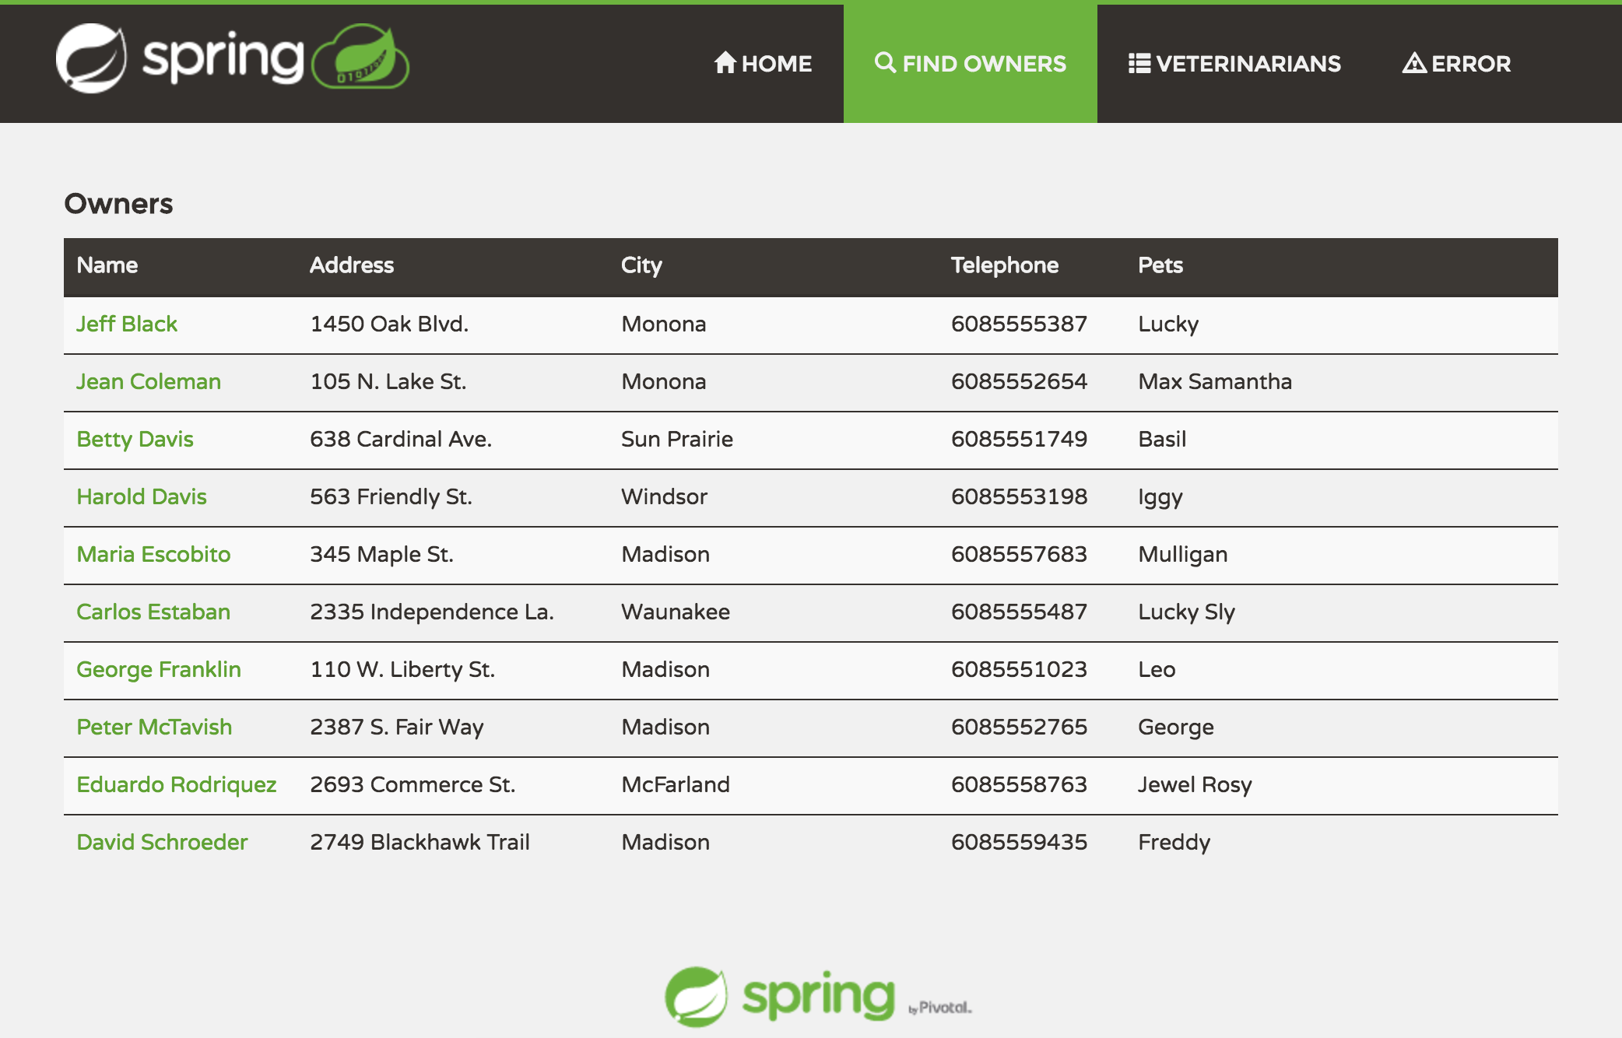
Sample Application Intro
Petclinic is a Spring Boot application built using Maven.
Notes:
/usr/share/nginx/html

Slide 44
Sample Application Intro
Checkout the code:
git clone https://github.com/spring-projects/spring-petclinic.git
Build application:
cd spring-petclinic
./mvnw package
Run application:
java -jar target/spring-petclinic*.jar
Notes:
/usr/share/nginx/html

Slide 45
Let’s Dockerize It
Create application image based on our java base image with:
spring-petclinic-2.1.0.BUILD-SNAPSHOT.jar
-jar <path>/spring-petclinic-2.1.0.BUILD-SNAPSHOT.jar as command
Is our setup persistent?
Notes:
/usr/share/nginx/html

Slide 46
We need to use external db!
Run mysql:
docker run -e MYSQL_ROOT_PASSWORD=petclinic -e MYSQL_DATABASE=petclinic -p 3306:3306 mysql:5.7.25
Run application with mysql profile
java -Dspring.profiles.active=mysql -jar <path>/spring-petclinic-2.1.0.BUILD-SNAPSHOT.jar
Configure dedicated profie (application-mysql.properties) via volume
Notes:
/usr/share/nginx/html

Slide 47
We need to use external db!
# database init, supports mysql too
database=mysql
spring.datasource.url=jdbc:mysql://petclinicdb/petclinic
spring.datasource.username=root
spring.datasource.password=petclinic
# Uncomment this the first time the app runs
# spring.datasource.initialization-mode=always
Notes:
/usr/share/nginx/html

Slide 48
We need to be profesional!
Let's add web tier based on nginx base image and configure backed via volume (/etc/nginx/sites-enabled/default):
server {
listen 80;
server_name _;
location ~ ^/ {
proxy_pass http://petclinic:8080;
}
}
Notes:
/var/www/html

Slide 49
We need to be secure!
Let’s generate root certificate:
openssl req -new -x509 -days 365 -keyout ca-key.pem -out ca-crt.pem
Generate nginx key:
openssl genrsa -out server-key.pem
Generate certificate request:
openssl req -new -sha256 -key server-key.pem -out server-csr.pem
Notes:
/usr/share/nginx/html

Slide 50
We need to be secure!
Sign certificate request:
openssl x509 -req -sha256 -days 365 -in server-csr.pem -CA ca-crt.pem -CAkey ca-key.pem -CAcreateserial -out server-crt.pem
Verify certificate:
openssl x509 -noout -text -in server-crt.pem
Modify nginx configuration via volume (/etc/nginx/conf.d/default.conf):
Notes:
/usr/share/nginx/html

Slide 51
We need to be secure!
server {
listen 443 ssl;
server_name _;
ssl_certificate /server-crt.pem;
ssl_certificate_key /server-key.pem;
ssl_protocols TLSv1 TLSv1.1 TLSv1.2;
ssl_ciphers HIGH:!aNULL:!MD5;
location ~ ^/ {
proxy_pass http://petclinic:8080;
}
}
Notes:
/usr/share/nginx/html

Slide 52
Multi Stage Example
FROM maven:slim
RUN git clone https://github.com/spring-projects/spring-petclinic.git
RUN cd spring-petclinic
RUN mvn clean package
RUN mv target/spring-petclinic-2.1.0.BUILD-SNAPSHOT.jar /spring-petclinic.jar
FROM openjdk:8-jre-slim
COPY --from=0 /spring-petclinic.jar .
ENTRYPOINT [ "/usr/bin/java" ]
CMD [ "-jar", "/spring-petclinic.jar" ]
Notes:
/usr/share/nginx/html

Slide 53

Docker Compose
Compose is a tool for defining and running multi-container Docker applications. With Compose, you use a YAML file to configure your application’s services.
Notes:
/usr/share/nginx/html

Slide 54
Docker Compose - Features
The features of Compose that make it effective are:
Multiple isolated environments on a single host
Preserve volume data when containers are created
Only recreate containers that have changed
Variables and moving a composition between environments
Notes:
/usr/share/nginx/html

Slide 55
Docker Compose - Install
Linux installation:
sudo curl -L "https://github.com/docker/compose/releases/download/1.23.2/docker-compose-$(uname -s)-$(uname -m)" -o /usr/local/bin/docker-compose
sudo chmod +x /usr/local/bin/docker-compose
docker-compose –version
More installation can be found here: https://docs.docker.com/compose/install/
Notes:
/usr/share/nginx/html

Slide 56
Docker Compose – docker-compose.yml
version: '2.1'
services:
app-ubuntu:
container_name: app-ubuntu
image: ubuntu:18:04
privileged: true
networks:
app_default:
ipv4_address: 172.16.0.11
restart: always
hostname: app-ubuntu
entrypoint: /bin/bash
volumes:
- app-ubuntu:/path:rw
- ${PWD}/file:/path/file:ro
Notes:
/usr/share/nginx/html

Slide 57
Docker Compose
volumes:
app-ubuntu:
driver: local
networks:
app_default:
driver: bridge
ipam:
config:
- subnet: 172.16.0.0/16
gateway: 172.16.0.1
More information can be found here: https://docs.docker.com/compose/compose-file/
Notes:
/usr/share/nginx/html

